Slide 1
Lecture 11 Shortest Paths
Department of Computer Science
Hofstra University

Slide 2
Lecture Goals
In this lecture we study shortest-paths problems. We begin by analyzing some basic properties of shortest paths and a generic algorithm for the problem.
We introduce and analyze Dijkstra's algorithm for shortest-paths problems with nonnegative weights.
Next, we consider Topological Sort for Edge-weighted DAG, which works even if the weights are negative.
We conclude with the Bellman–Ford algorithm for edge-weighted digraphs with no negative cycles.
We conclude with the Floyd Warshall Algorithm for all-pairs shortest path

Slide 3
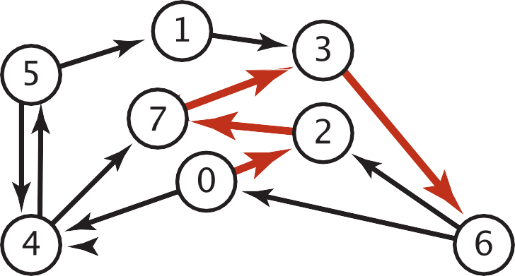
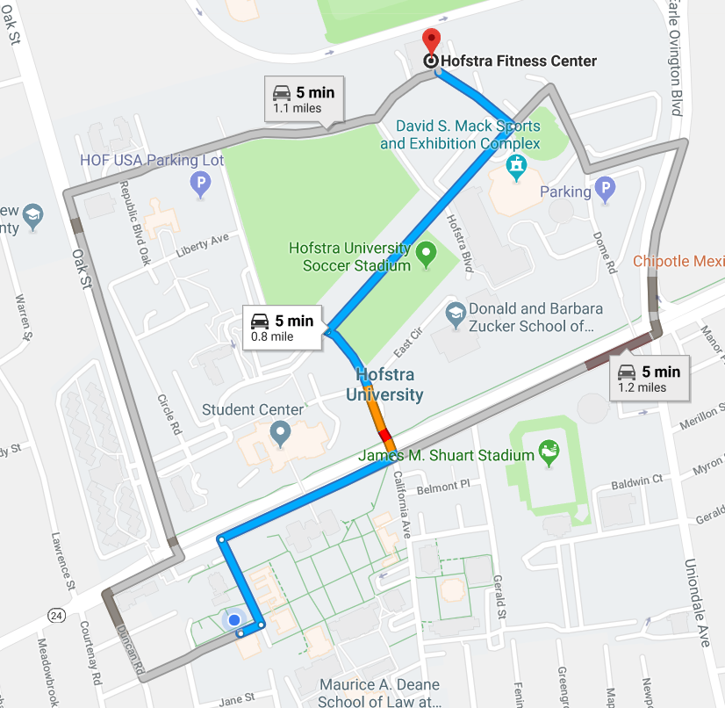

Shortest Paths in an Edge-weighted Digraph
Given an edge-weighted digraph, find the shortest path from s to t.
edge-weighted digraph
shortest path from 0 to 6
0->2 0.26
4->5 | 0.35
5->4 | 0.35
4->7 | 0.37
5->7 | 0.28
7->5 | 0.28
5->1 | 0.32
0->4 | 0.38
0->2 | 0.26
7->3 | 0.39
1->3 | 0.29
2->7 | 0.34
6->2 | 0.40
3->6 | 0.52
6->0 | 0.58
6->4 | 0.93
2->7 | 0.34
7->3 | 0.39
3->6 | 0.52
Variants
Can we use BFS?
Which vertices?
Single source: from one vertex s to every other vertex.
Source-sink: from one vertex s to another t.
All pairs: between all pairs of vertices.
Nonnegative weights?
Cycles?
Negative cycles.
Simplifying assumption: Each vertex is reachable from s.

Slide 4
Weighted Directed Edge API
public class DirectedEdge
DirectedEdge(int v, int w, double weight) //weighted edge v->w
int from() // vertex v
int to() // vertex w
double weight() // the weight
String toString() // string representation
weight
v
w
Idiom for processing an edge e: int v = e.from(), w = e.to();

Slide 5

Weighted Edge: Java Implementation
public class DirectedEdge
{
private final int v, w; private final double weight;
public DirectedEdge(int v, int w, double weight)
{
this.v = v; this.w = w;
this.weight = weight;
}
public int from()
{ return v; }
public int to()
{ return w; }
public int weight()
{ return weight; }
}

Slide 6
Edge-Weighted Graph API
public class EdgeWeightedDigraph
EdgeWeightedDigraph(int V) // edge-weighted digraph with V vertices
void addEdge(DirectedEdge e) // add weighted directed edge e
Iterable <DirectedEdge> adj(int v) // edges pointing from v
Iterable <DirectedEdge> edges() // all edges in this graph
int V() // number of vertices
int E() // number of edges
String toString() // string representation
0 | 2 | .26 | →
0 | 1 | .38
adj
0
1
2
3
4
1 | 3 | .29
2 | 4 | .34
reference to a
DirectedEdge
object
3 | 2 | .52
4 | 2 | .26 | →
4 | 0 | .35

Slide 7

Edge-Weighted Digraph: Adjacency-Lists Implementation
public class EdgeWeightedDigraph
{
private final int V;
private final List<DirectedEdge>[] adj;
public EdgeWeightedDigraph (int V)
{
this.V = V;
adj = (List<DirectedEdge>[]) new ArrayList[V];
for (int v = 0; v < V; v++)
adj[v] = new ArrayList<DirectedEdge>();
}
public void addEdge(DirectedEdge e)
{
int v = e.from();
adj[v].add(e);
}
add edge e = v->w to only v’s adjacency lists
public Iterable<DirectedEdge> adj(int v)
{ return adj[v]; }
}

Slide 8

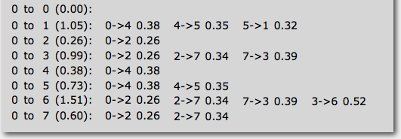
Single-source Shortest Paths API
Goal. Find the shortest path from s to every other vertex.
public class SP
SP(EdgeWeightedGraph G, int s) // shortest paths from s in graph G
double distTo(int v) // length of shortest path from s to v
Iterable <DirectedEdge> pathTo(int v) // shortest path from s to v
SP sp = new SP(G, s);
for (int v = 0; v < G.V(); v++)
{
StdOut.printf("%d to %d (%.2f): ", s, v, sp.distTo(v));
for (DirectedEdge e : sp.pathTo(v)) {
StdOut.print(e + " ");
StdOut.println();
}
}

Slide 9
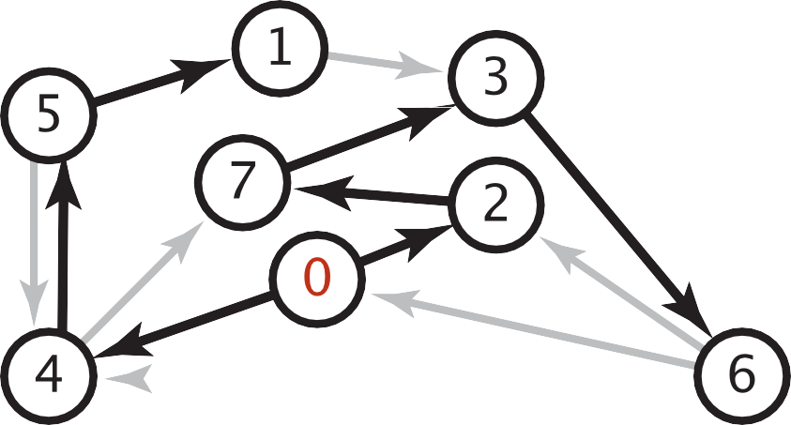

Data Structures for Single-source Shortest Paths
Goal. Find the shortest path from s to every other vertex.
Observation. A shortest-paths tree (SPT) solution exists.
Consequence. Can represent the SPT with two vertex-indexed arrays:
distTo[v] is length of shortest path from s to v.
edgeTo[v] is last edge on shortest path from s to v.
shortest-paths tree from 0
edgeTo[]
distTo[]
public double distTo(int v)
{ return distTo[v]; }
0
1
2
3
4
5
6
7
null 0
5->1 0.32 1.05
0->2 0.26 0.26
7->3 0.37 0.97
0->4 0.38 0.38
4->5 0.35 0.73
3->6 0.52 1.49
2->7 0.34 0.60
public Iterable<DirectedEdge> pathTo(int v)
{
Stack<DirectedEdge> path = new Stack<DirectedEdge>();
for (DirectedEdge e = edgeTo[v]; e != null; e = edgeTo[e.from()])
path.push(e);
return path;
}
parent-link representation

Slide 10

Edge Relaxation
Relax edge e = v→w. (basic of building SPT)
distTo[v] is length of shortest known path from s to v.
distTo[w] is length of shortest known path from s to w.
edgeTo[w] is last edge on shortest known path from s to w.
If e = v→w gives shorter path to w through v, update distTo[w] and edgeTo[w].
private void relax(DirectedEdge e)
{
int v = e.from(), w = e.to();
if (distTo[w] > distTo[v] + e.weight())
{
distTo[w] = distTo[v] + e.weight();
edgeTo[w] = e;
}
}
edgeTo[w] = v
relax edge v→w
3.1
v
1.3
s
w
7.2
black edge are in edgeTo[ ]
OLD distTo[w] = 7.2 > distTo[v] + e.weight()
= 3.1+1.3 = 4.4
NEW distTo[w] ← distTo[v] + e.weight() = 4.4
= 3.1+1.3 = 4.4

Slide 11
Generic Shortest-paths Algorithm
Generic algorithm (to compute SPT from s)
For each vertex v: distTo[v] = ∞.
For each vertex v: edgeTo[v] = null.
distTo[s] = 0.
Repeat until done:
- Relax any edge.
Proposition. Generic algorithm computes SPT (if it exists) from s.
Pf.
Throughout algorithm, distTo[v] is the length of a simple path from s to v (and edgeTo[v] is last edge on path).
Each successful relaxation decreases distTo[v] for some v.
The entry distTo[v] can decrease at most a finite number of times.
Efficient implementations. How to choose which edge to relax?
Ex 1. Dijkstra’s algorithm. (nonnegative weights, directed cycles).
Ex 2. Topological sort algorithm. (no directed cycles).
Ex 3. Bellman–Ford algorithm. (no negative cycles).

Slide 12
Dijkstra's Algorithm
Initialization:
Set the distance to the source node as 0 and to all other nodes as infinity.
Mark all nodes as unvisited and store them in a priority queue.
Main Loop:
Extract the unvisited node with the smallest known distance from the queue.
For each neighboring node, calculate its tentative distance through the current node. If this distance is smaller than the previously recorded distance, update it.
Mark the current node as visited once all its neighbors are processed.
Termination:
The algorithm continues until all reachable nodes are visited, or until the shortest path to a specific destination is found.

Slide 13
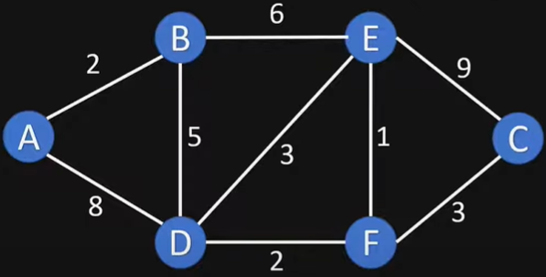
Example Graph

Slide 14
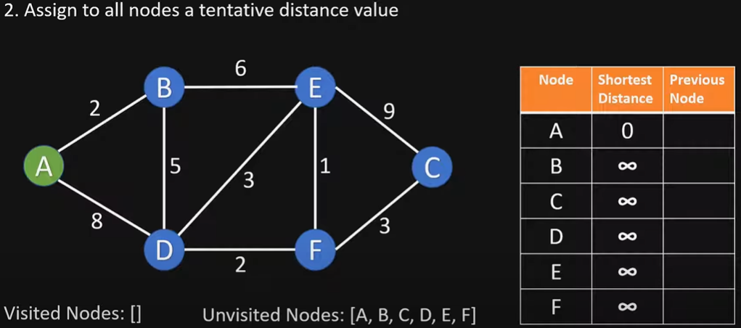

Slide 15
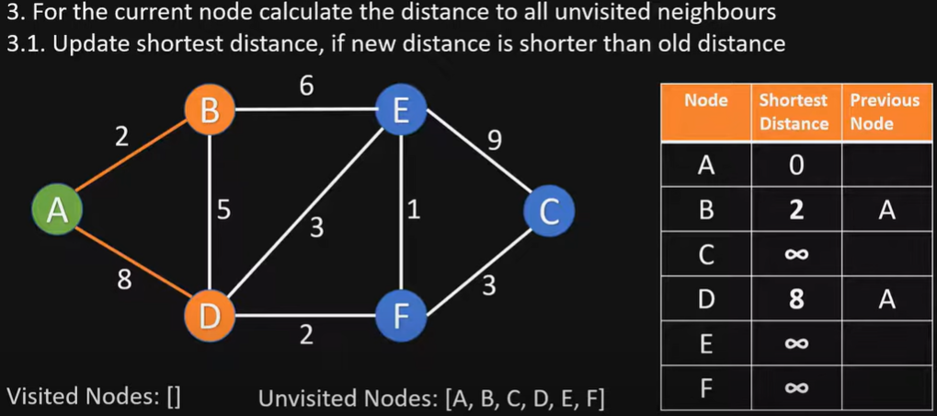
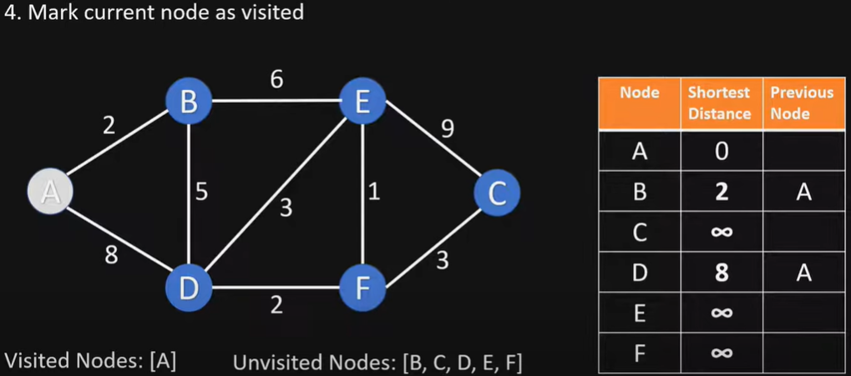
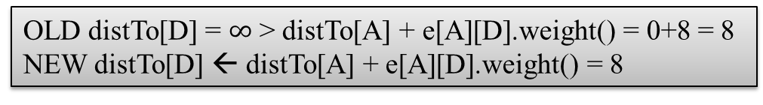
OLD distTo[D] = $∞$ > distTo[A] + e[A][D].weight() = 0+8 = 8
NEW distTo[D] ← distTo[A] + e[A][D].weight() = 8

Slide 16
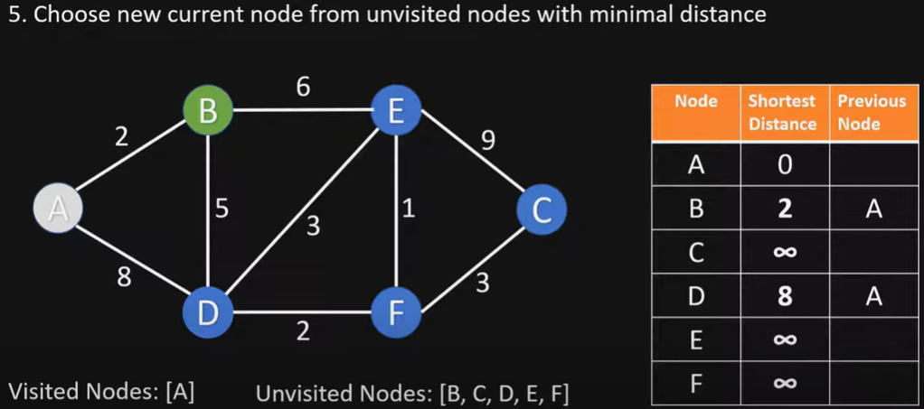
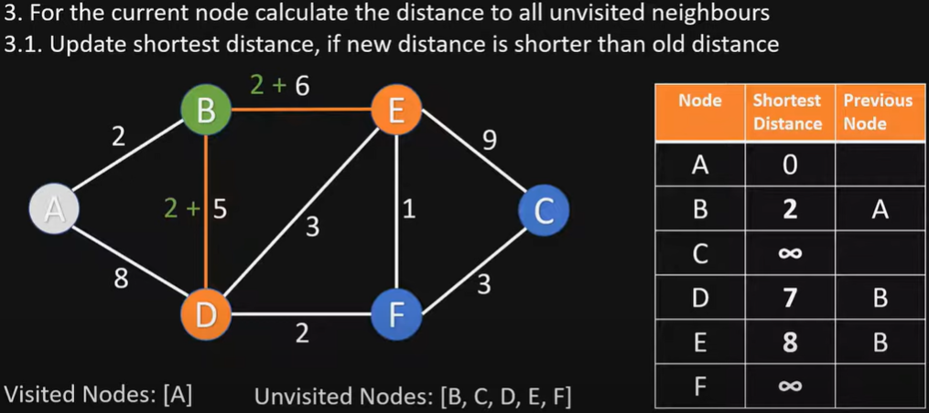
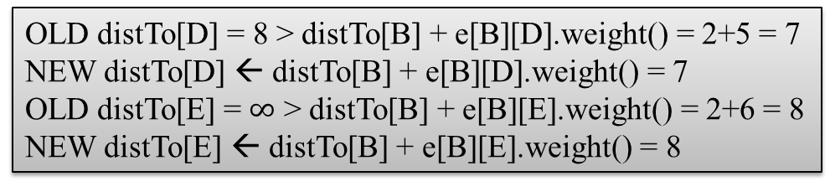
OLD distTo[D] = 8 > distTo[B] + e[B][D].weight() = 2+5 = 7
NEW distTo[D] ← distTo[B] + e[B][D].weight() = 7
OLD distTo[E] = $∞$ > distTo[B] + e[B][E].weight() = 2+6 = 8
NEW distTo[E] ← distTo[B] + e[B][E].weight() = 8

Slide 17
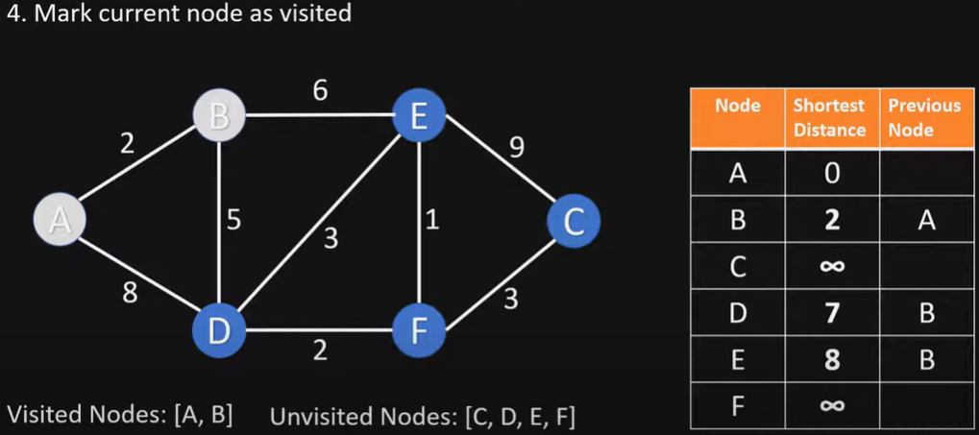
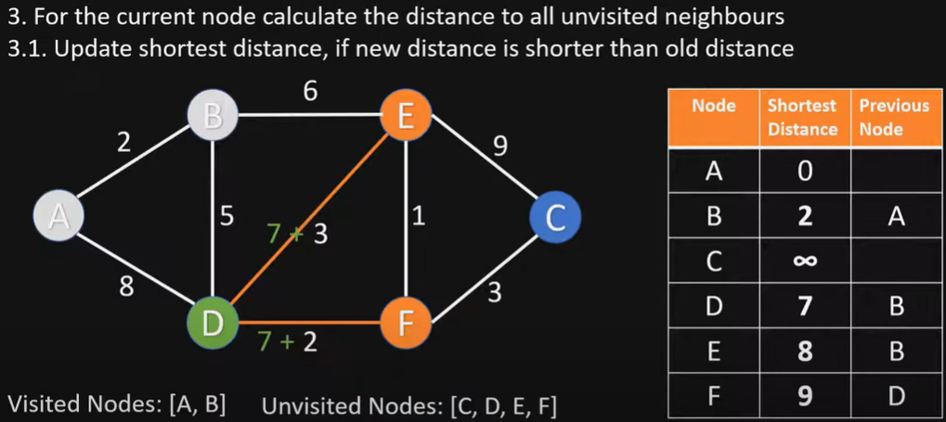
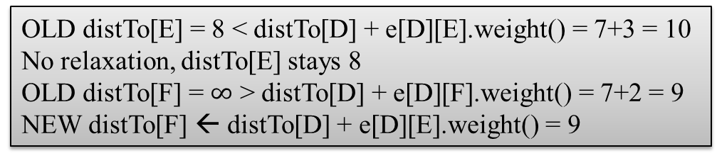
OLD distTo[E] = 8 < distTo[D] + e[D][E].weight() = 7+3 = 10
No relaxation, distTo[E] stays 8
OLD distTo[F] = $∞$ > distTo[D] + e[D][F].weight() = 7+2 = 9
NEW distTo[F] ← distTo[D] + e[D][E].weight() = 9

Slide 18
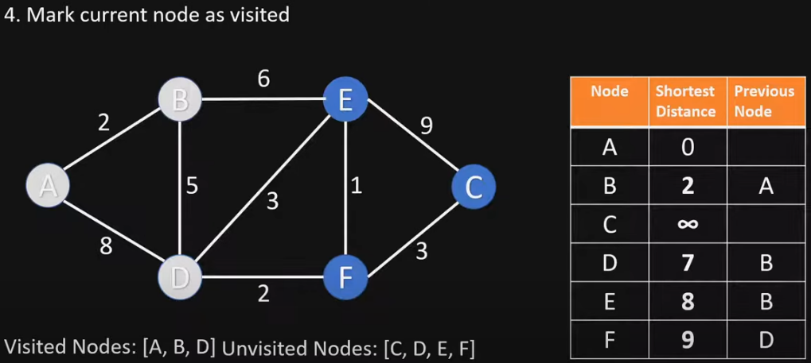
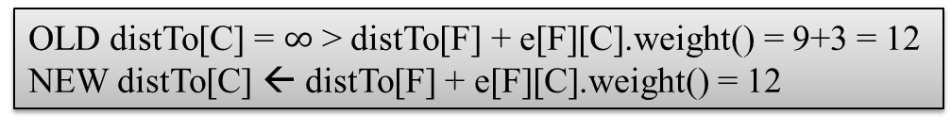
OLD distTo[C] = $∞$ > distTo[F] + e[F][C].weight() = 9+3 = 12
NEW distTo[C] ← distTo[F] + e[F][C].weight() = 12

Slide 19
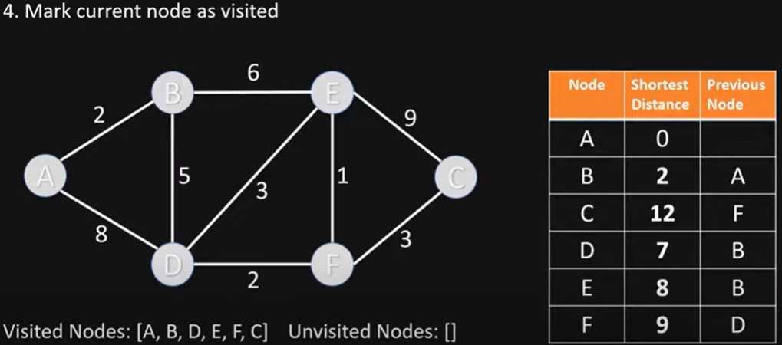
End of Algorithm
Table contains the shortest distance to each node N from the source node A, and its previous node in the shortest path

Slide 20
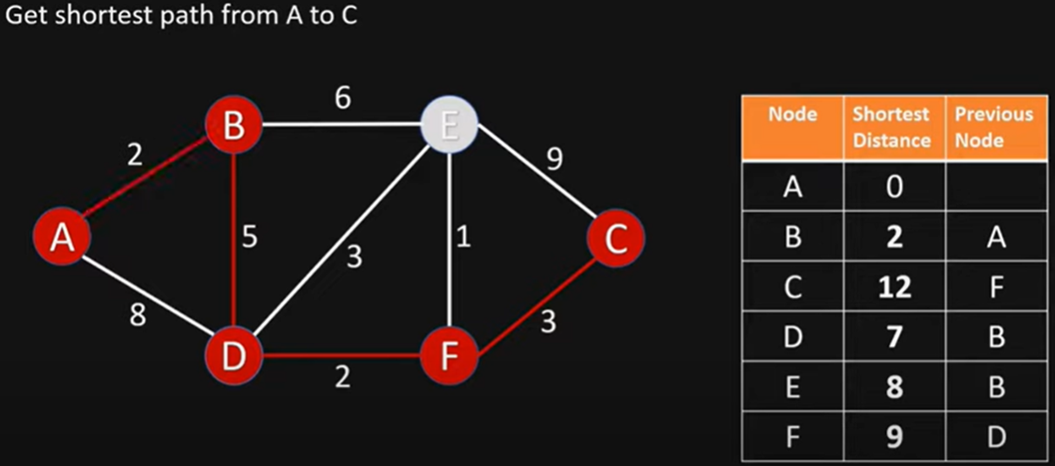
Getting the Shortest Path from A to C
C’s previous node is F; F’s previous node is D; D’s previous node is B; B’s previous node is A
Shortest Path from A to C is ABDFC

Slide 21
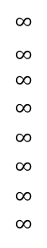
Dijkstra’s Algorithm 2nd Example
choose vertex 5
relax all edges adjacent from 5
choose vertex 2
relax all edges adjacent from 2
choose vertex 3
relax all edges adjacent from 3
choose vertex 6
relax all edges adjacent from 6
Consider vertices in increasing order of distance from s
(non-tree vertex with the lowest distTo[ ] value).
Add vertex to tree and relax all edges pointing from that vertex.
1
v distTo[]
15
3
$$∞$$
$∞$ $∞$
$$∞$$
$$∞$$
$$∞$$
$$∞$$
$$∞$$
0
5
17
20
9
14
29
8
15
17
13
26
14
25
0
1
2
3
4
5
6
7
5
4
12
0
3
8
7
2
7
9
9
5
6
1
5
11
v edgeTo[]
4
4
13
6
0
1
2
3
4
5
6
7
-
-
-
-
-
-
-
-
0
1
1
0
7
4
0
7
2
4
5
5
2
20
choose source vertex 0
relax all edges adjacent from 0
choose vertex 1
relax all edges adjacent from 1
choose vertex 7
relax all edges adjacent from 7
choose vertex 4
relax all edges adjacent from 4

Slide 22
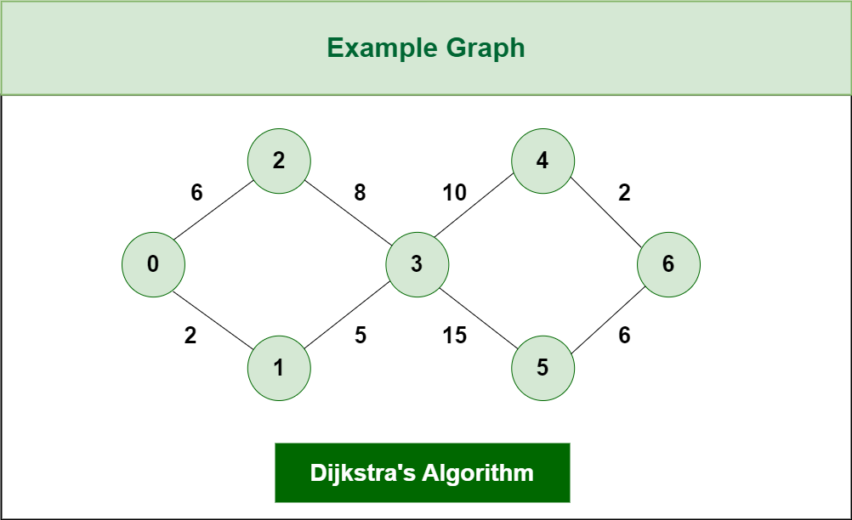
Dijkstra’s Algorithm 3rd Example

Slide 23
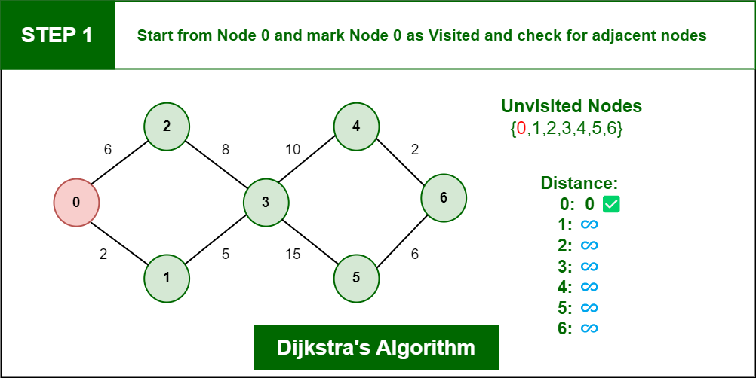
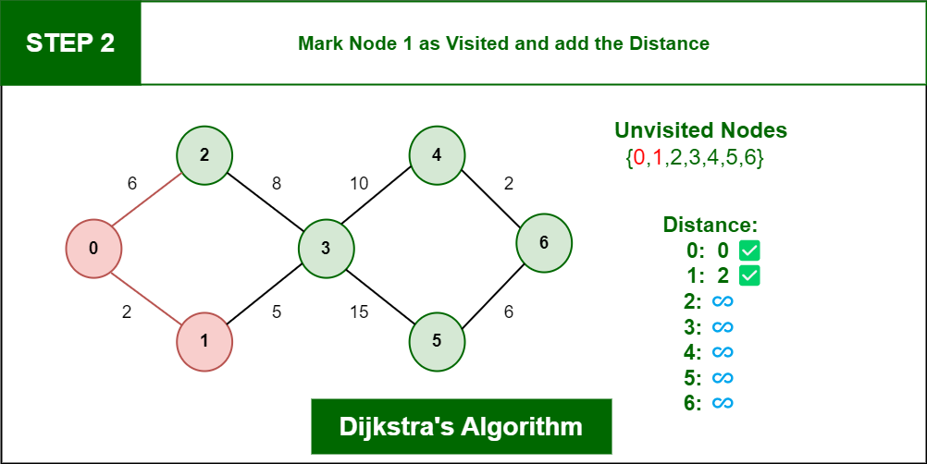
Step 1: Start from Node 0 and mark it as visited
Step 2: Check for adjacent Nodes, Now we have 2 choices (Either Node1 with distance 2 or Node 2 with distance 6 ) and choose Node with minimum distance. In this step Node 1 is Minimum distance adjacent Node, so marked it as visited and add up the distance.
Distance: Node 0 -> Node 1 = 2

Slide 24
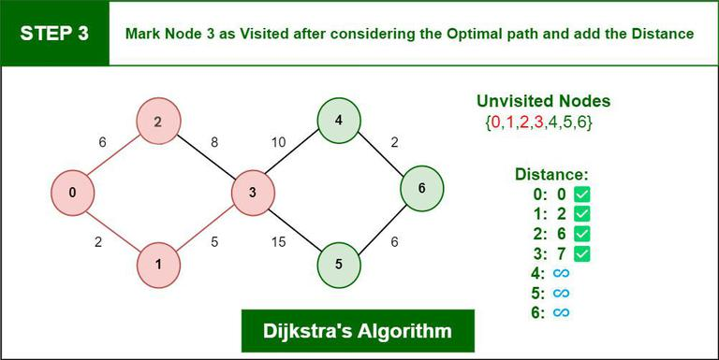
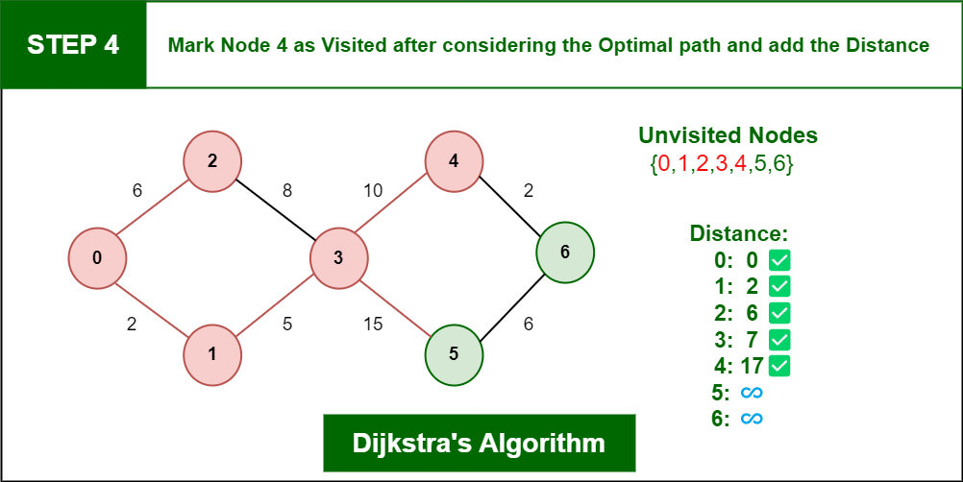
Step 3: Check for adjacent Node which is Node 3, so marked it as visited and add up the distance, Now the distance will be:
Distance: Node 0 -> Node 1 -> Node 3 = 2 + 5 = 7
Step 4: We have two choices for adjacent Nodes (Either Node 4 with distance 10 or Node 5 with distance 15) so choose Node 4, so marked it as visited and add up the distance.
Distance: Node 0 -> Node 1 -> Node 3 -> Node 4 = 2 + 5 + 10 = 17

Slide 25
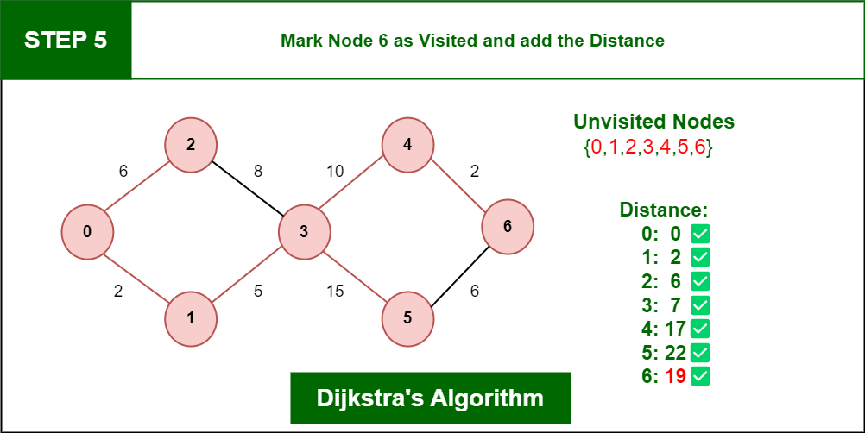
Step 5: Check for adjacent Node which is Node 6, so marked it as visited and add up the distance, Now the distance will be:
Distance: Node 0 -> Node 1 -> Node 3 -> Node 4 -> Node 6 = 2 + 5 + 10 + 2 = 19

Slide 26
Dijkstra’s Algorithm: Correctness Proof
Proposition. Dijkstra's algorithm computes a SPT in any edge-weighted digraph with nonnegative weights.
Pf.
Each edge e = v→w is relaxed exactly once (when v is relaxed),
leaving distTo[w] ≤ distTo[v] + e.weight().
Inequality holds until algorithm terminates because:
distTo[w] cannot increase
distTo[v] will not change
Thus, upon termination, shortest-paths optimality conditions hold.
distTo[ ] values are monotone decreasing
we choose lowest distTo[ ] value at each step (and edge weights are nonnegative)

Slide 27
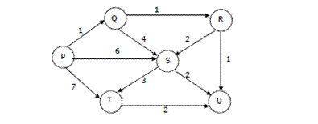
Quiz: Dijstra’s Algorithm
Suppose we run Dijkstra’s single source shortest-path algorithm on the following edge weighted directed graph with vertex P as the source. In what order do the nodes get included into the set of vertices for which the shortest path distances are finalized?
ANS: P, Q, R, U, S, T

Slide 28
Topological Sort for Shortest Paths in Edge-weighted DAG
Initialize dist[] = {INF, INF, ….} and dist[s] = 0 where s is the source vertex.
Create a topological order of all vertices.
Do following for every vertex u in topological order.
………..Do following for every adjacent vertex v of u
………………if (dist[v] > dist[u] + weight(u, v)) //relax edge uv
………………………dist[v] = dist[u] + weight(u, v)
Time Complexity: Time complexity of topological sorting is O(V+E). After finding topological order, the algorithm process all vertices and for every vertex, it runs a loop for all adjacent vertices. Total adjacent vertices in a graph is O(E). So the inner loop runs O(V+E) times. Therefore, overall time complexity of this algorithm is O(V+E).

Slide 29
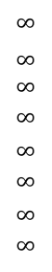
Topological Sort for Shortest Paths in Edge-weighted DAG
Suppose that an edge-weighted digraph has no directed cycles. Is it easier to find shortest paths than in a general digraph?
Yes!
Consider vertices in topological order.
Relax all edges pointing from that vertex
v distTo[]
0
1
2
3
4
5
6
7
$$∞$$
$∞$ $∞$
$$∞$$
$$∞$$
$$∞$$
$$∞$$
$$∞$$
0
5
17
20
9
13
29
8
15
17
26
14
25
0 1 4 7 5 2 3 6
1
15
3
5
4
12
0
3
v edgeTo[]
8
7
2
0
1
2
3
4
5
6
7
-
-
-
-
-
-
-
-
0
1
1
0
4
4
0
7
2
5
5
2
7
9
9
5
6
1
5
11
4
4
13
20
6

Slide 30
Shortest Paths in Edge-weighted DAG: Correctness Proof
Proposition. Topological sort algorithm computes SPT in any edge- weighted DAG in time proportional to E + V.
edge weights
can be negative!
Pf.
Each edge e = v→w is relaxed exactly once (when v is relaxed),
leaving distTo[w] ≤ distTo[v] + e.weight().
Inequality holds until algorithm terminates because:
distTo[w] cannot increase
distTo[v] will not change
Thus, upon termination, shortest-paths optimality conditions hold.
distTo[ ] values are monotone decreasing
because of topological order, no edge pointing to v will be relaxed after v is relaxed

Slide 31
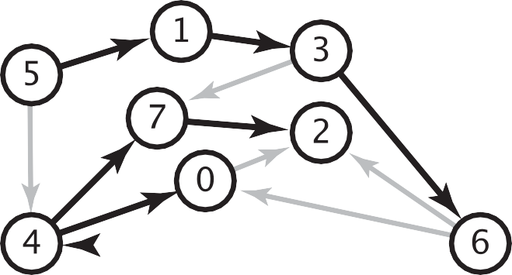
Longest Paths in Edge-weighted DAG
Formulate as a shortest paths problem in edge-weighted DAGs.
Negate all weights.
Find shortest paths.
Negate weights in result.
equivalent: reverse sense of equality in relax()
longest paths input
shortest paths input
5->4 | 0.35 | 5->4 | -0.35
4->7 | 0.37 | 4->7 | -0.37
5->7 | 0.28 | 5->7 | -0.28
5->1 | 0.32 | 5->1 | -0.32
4->0 | 0.38 | 4->0 | -0.38
0->2 | 0.26 | 0->2 | -0.26
3->7 | 0.39 | 3->7 | -0.39
1->3 | 0.29 | 1->3 | -0.29
7->2 | 0.34 | 7->2 | -0.34
6->2 | 0.40 | 6->2 | -0.40
3->6 | 0.52 | 3->6 | -0.52
6->0 | 0.58 | 6->0 | -0.58
6->4 | 0.93 | 6->4 | -0.93
s
Key point. Topological sort algorithm works even with negative weights.

Slide 32
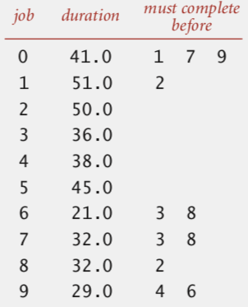
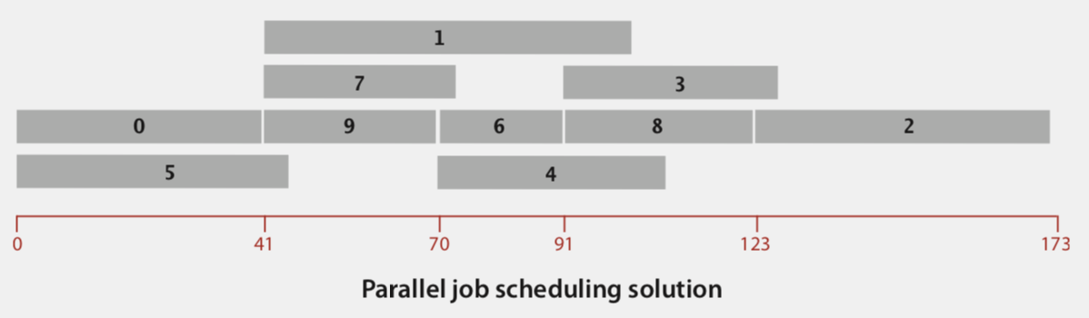
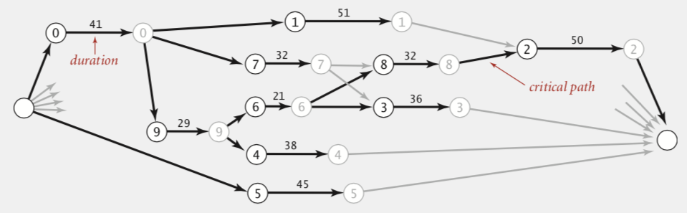
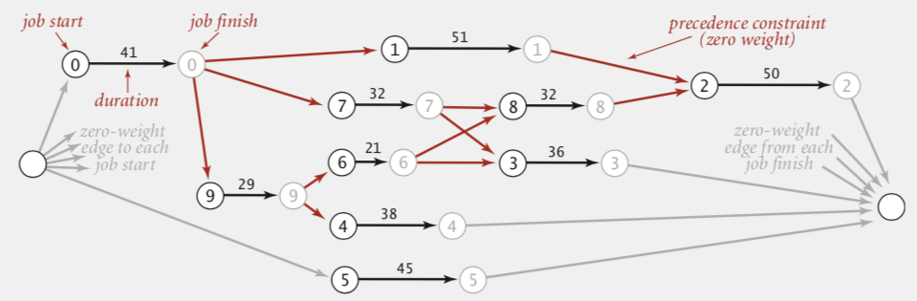
Longest Paths in Edge-weighted DAG: Application
Parallel job scheduling. Given a set of jobs with durations and precedence constraints, schedule the jobs (by finding a start time for each) so as to achieve the minimum completion time, while respecting the constraints.
Critical Path Method. To solve this problem, create edge-weighted DAG:
Source and sink vertices.
Two vertices (begin and end) for each job
Three edges for each job.
begin to end (weighted by duration)
source to begin (0 weight)
end to sink (0 weight)
One edge for each precedence constraint (0 weight).
Use longest path from the source to schedule each job.

Slide 33
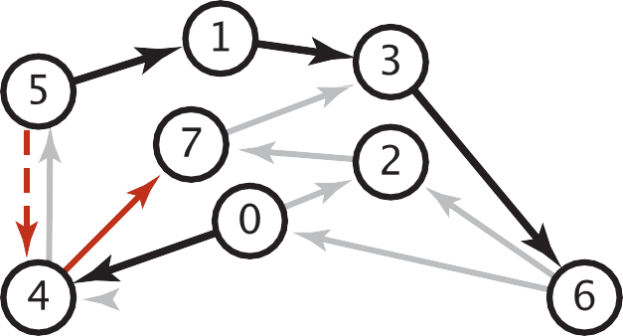
Shortest Paths with Negative weights
Dijkstra. Doesn’t work with negative edge weights.
0
4
1
0
13
1
Conclusion.
Need a different algorithm.
2
6
11
15
3
-9
2
3
0
2
Dijkstra selects vertex 3 immediately after 0. But shortest path from 0 to 3 is 0→1→2→3.
Adding 9 to each edge weight changes the shortest path from 0→1→2→3 to 0→3.
4->5 | 0.35
5->4 | -0.66
4->7 | 0.37
5->7 | 0.28
7->5 | 0.28
5->1 | 0.32
0->4 | 0.38
0->2 | 0.26
7->3 | 0.39
1->3 | 0.29
2->7 | 0.34
6->2 | 0.40
3->6 | 0.52
6->0 | 0.58
6->4 | 0.93
Re-weighting. Add a constant to every edge weight doesn’t work.
A negative cycle is a directed cycle whose sum of edge weights is negative.
A SPT exists iff no negative cycles, assuming all vertices reachable from s
negative cycle (-0.66 + 0.37 + 0.28)
5->4->7->5
shortest path from 0 to 6
0->4->7->5->4->7->5...->1->3->6
Shortest Path Algorithms Explained (Dijkstra's & Bellman-Ford https://www.youtube.com/watch?v=AE5I0xACpZs

Slide 34
Bellman-Ford Algorithm
Initialize distance array dist[] for each vertex ‘v‘ as dist[v] = INFINITY.
Assume any vertex (let’s say ‘0’) as source and assign dist = 0.
Relax all the edges(u,v,weight) N-1 times as per the below condition:
dist[v] = minimum(dist[v], distance[u] + weight)
Bellman–Ford algorithm
For each vertex v: distTo[v] = ∞.
For each vertex v: edgeTo[v] = null.
distTo[s] = 0.
Repeat V-1 times:
- Relax each edge.
for (int i = 1; i < G.V(); i++)
for (int v = 0; v < G.V(); v++)
for (DirectedEdge e : G.adj(v))
relax(e);
pass i
(relax
each edge)
Time complexity for connected graph: Best Case: O(E), when distance array after 1st and 2nd relaxation are same , we can simply stop further processing
Average Case: O(V*E)
Worst Case: O(V*E)
Notes:
Now, Relax all the edges one more time i.e. the Nth time and based on the below two cases we can detect the negative cycle:
Case 1 (Negative cycle exists): For any edge(u, v, weight), if dist[u] + weight < dist[v]
Case 2 (No Negative cycle) : case 1 fails for all the edges.

Slide 35
Bellman-Ford Algorithm Proof of Correctness
Relaxing edges V-1 times in the Bellman-Ford algorithm guarantees that the algorithm has explored all possible paths of length up to V-1, which is the maximum possible length of a shortest path in a graph with V vertices. This allows the algorithm to correctly calculate the shortest paths from the source vertex to all other vertices, given that there are no negative-weight cycles.

Slide 36
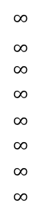
Bellman-Ford Algorithm Example
Repeat V − 1 times: relax all E edges.
v distTo[]
0
1
2
3
4
5
6
7
$$∞$$
$∞$ $∞$
$$∞$$
$$∞$$
$$∞$$
$$∞$$
$$∞$$
0
5
17
20
9
13
28
8
14
17
26
25
1
15
3
5
4
12
0
3
8
7
2
7
9
v edgeTo[]
9
5
6
1
0
1
2
3
4
5
6
7
-
-
-
-
-
-
-
-
0
1
1
0
4
2
0
5
2
5
2
5
11
4
4
13
20
6
pass 1
pass 2
pass 3
(no further changes)
pass 4-7 (no further changes)
0→1 0→4 0→7 1→2 1→3 1→7 2→3 2→6 3→6 4→5 4→6 4→7 5→2 5→6 7→2 7→5

Slide 37
Finding Negative Cycle in a Directed Weighted Graph Using Bellman-Ford
Initialize distance array dist[] for each vertex ‘v‘ as dist[v] = INFINITY.
Assume any vertex (let’s say ‘0’) as source and assign dist = 0.
Relax all the edges(u,v,weight) N-1 times as per the below condition:
dist[v] = minimum(dist[v], distance[u] + weight)
Now, Relax all the edges one more time i.e. the Nth time and based on the below two cases we can detect the negative cycle:
Case 1 (Negative cycle exists): For any edge(u, v, weight), if dist[u] + weight < dist[v]
Case 2 (No Negative cycle) : case 1 fails for all the edges.

Slide 38
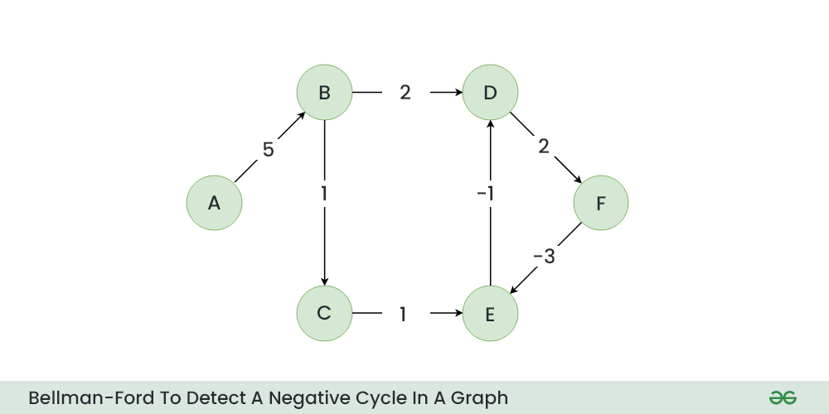
Bellman-Ford Example

Slide 39
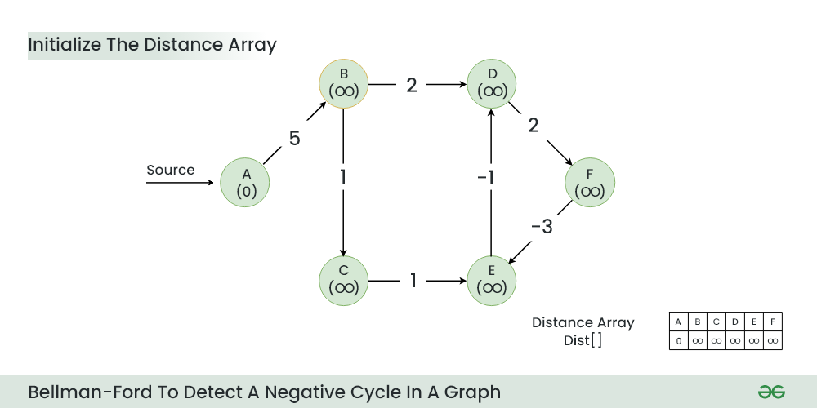
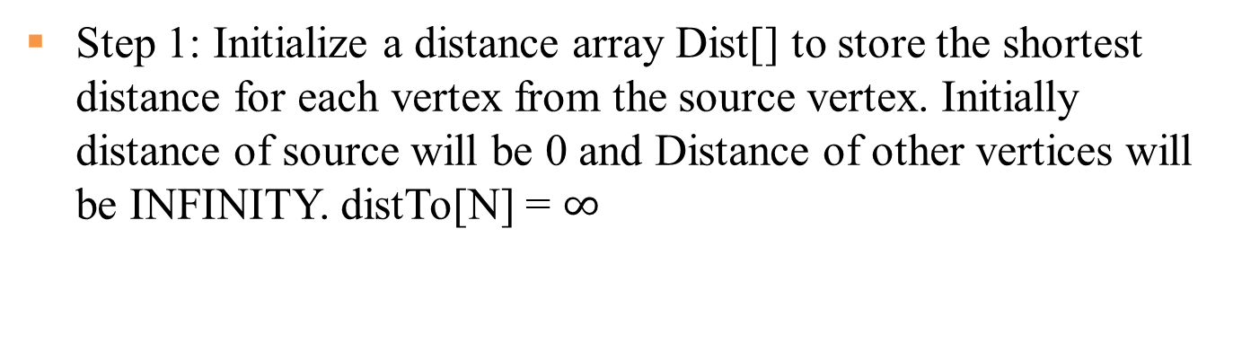
Step 1: Initialize a distance array Dist[] to store the shortest distance for each vertex from the source vertex. Initially distance of source will be 0 and Distance of other vertices will be INFINITY. distTo[N] = $∞$

Slide 40
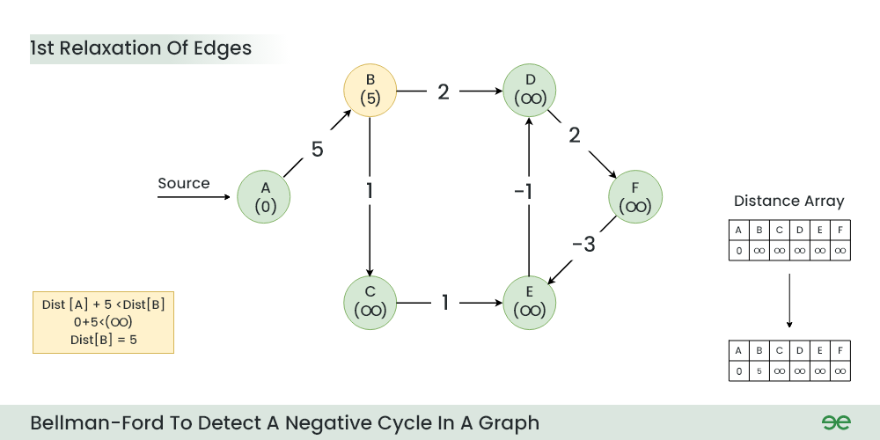
Step 2: Start relaxing the edges, during 1st relaxation:
OLD distTo[B] = ∞ > distTo[A] + e[A][B].weight() = 0+5 = 5
NEW distTo[B] = distTo[A] + e[A][B].weight() = 5

Slide 41
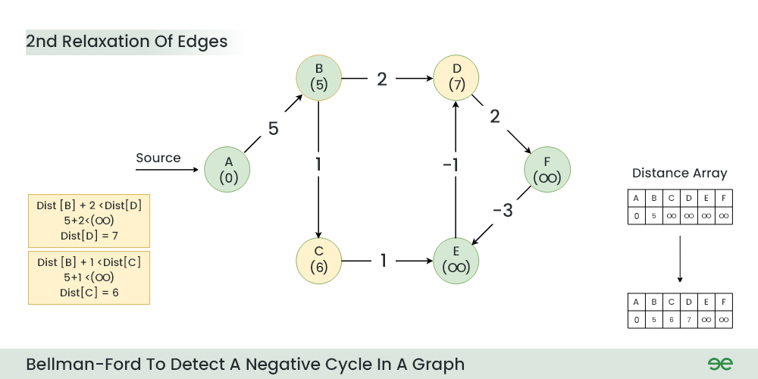
Step 3: During 2nd relaxation:
OLD distTo[D] = ∞ > distTo[B] + e[B][D].weight() = 5+2 = 7
NEW distTo[D] ← distTo[B] + e[B][D].weight() = 7
OLD distTo[C] = ∞ > distTo[B] + e[B][C].weight() = 5+1 = 6
NEW distTo[C] ← distTo[B] + e[B][C].weight() = 6

Slide 42
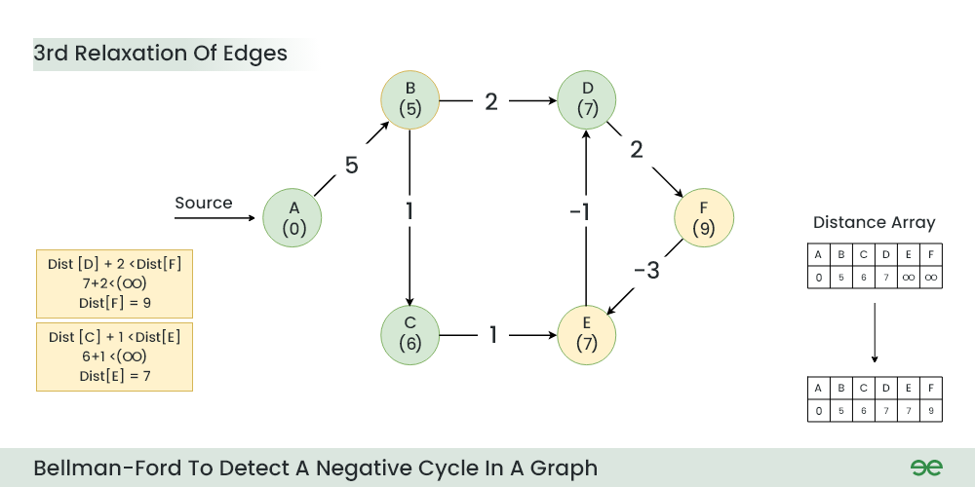
Step 4: During 3rd relaxation:
OLD distTo[F] = ∞ > distTo[D] + e[D][F].weight() = 7+2 = 9
NEW distTo[F] ← distTo[D] + e[D][F].weight() = 9
OLD distTo[E] = ∞ > distTo[C] + e[C][E].weight() = 6+1 = 7
NEW distTo[E] ← distTo[C] + e[C][E].weight() = 7
Notes:
Current Distance of F > (Distance of D ) + (Weight of D to F) i.e. Infinity > 7 + 2
Dist[F] = 9
Current Distance of E > (Distance of C ) + (Weight of C to E) i.e. Infinity > 6 + 1
Dist[E] = 7

Slide 43
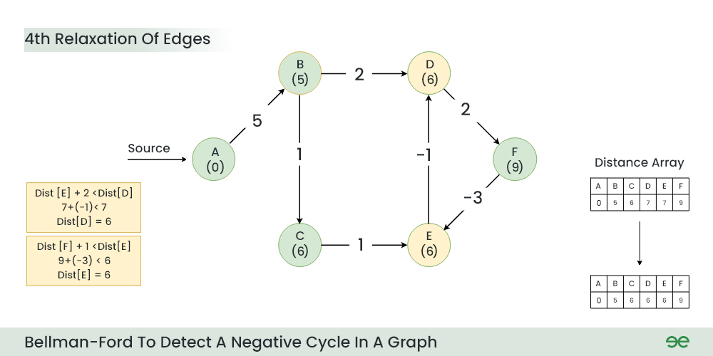
Step 5: During 4th relaxation:
OLD distTo[D] = 7 > distTo[E] + e[E][D].weight() = 7-1 = 6
NEW distTo[D] ← distTo[E] + e[E][D].weight() = 6
OLD distTo[E] = 7 > distTo[F] + e[F][E].weight() = 9-3 = 6
NEW distTo[E] ← distTo[F] + e[F][E].weight() = 6
Notes:
Current Distance of D > (Distance of E) + (Weight of E to D) i.e. 7 > 7 + (-1)
Dist[D] = 6
Current Distance of E > (Distance of F ) + (Weight of F to E) i.e. 7 > 9 + (-3)
Dist[E] = 6

Slide 44
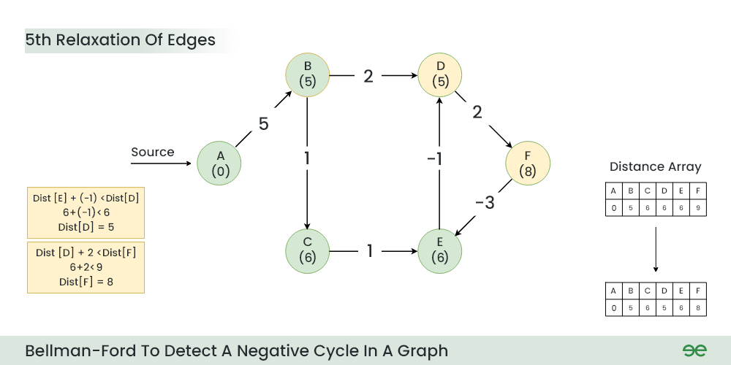
Step 6: During 5th relaxation:
OLD distTo[F] = 9 > distTo[D] + e[D][F].weight() = 6+2 = 8
NEW distTo[D] ← distTo[D] + e[D][F].weight() = 8
OLD distTo[D] = 6 > distTo[E] + e[E][D].weight() = 6-1 = 5
NEW distTo[E] ← distTo[E] + e[E][D].weight() = 5
Since the graph h 6 vertices, So during the 5th relaxation the shortest distance for all the vertices should have been calculated.
Notes:
Current Distance of F > (Distance of D) + (Weight of D to F) i.e. 9 > 6 + 2
Dist[F] = 8
Current Distance of D > (Distance of E ) + (Weight of E to D) i.e. 6 > 6 + (-1)
Dist[D] = 5

Slide 45
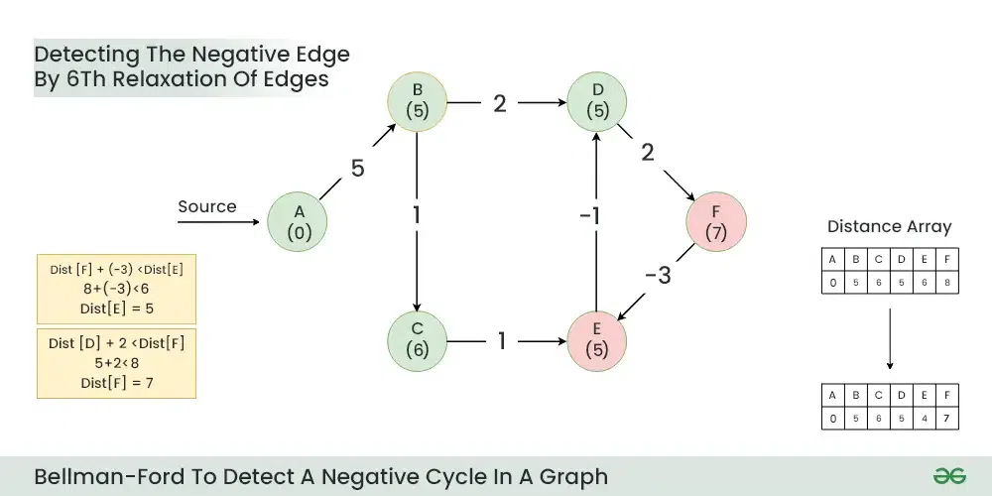
Step 7: Now the final relaxation i.e. the 6th relaxation should indicate the presence of negative cycle if there is any changes in the distance array of 5th relaxation.
During the 6th relaxation, following changes can be seen:
OLD distTo[E] = 6 > distTo[F] + e[F][E].weight() = 8-3 = 5
NEW distTo[D] ← distTo[F] + e[F][E].weight() = 5
OLD distTo[F] = 8 > distTo[D] + e[D][F].weight() = 5+2 = 7
NEW distTo[E] ← distTo[D] + e[D][F].weight() = 7
Since, we observer changes in the Distance array. Hence ,we can conclude the presence of a negative cycle in the graph (D->F->E).
Notes:
Current Distance of E > (Distance of F) + (Weight of F to E) i.e. 6 > 8 + (-3)
Dist[E]=5
Current Distance of F > (Distance of D ) + (Weight of D to F) i.e. 8 > 5 + 2
Dist[F]=7

Slide 46
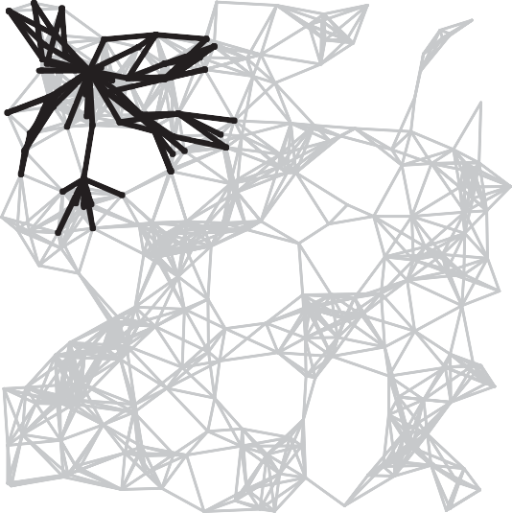
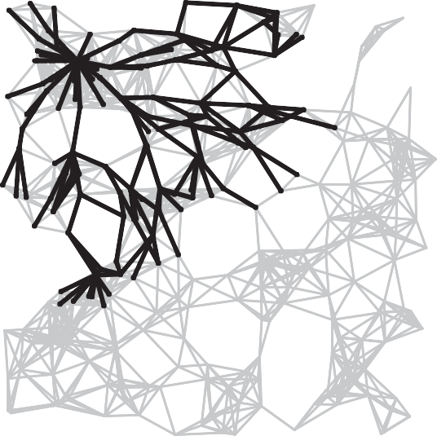
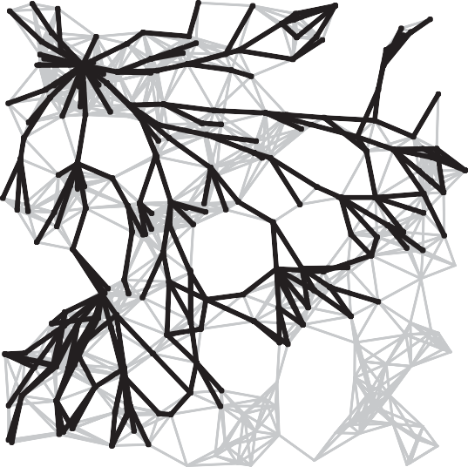
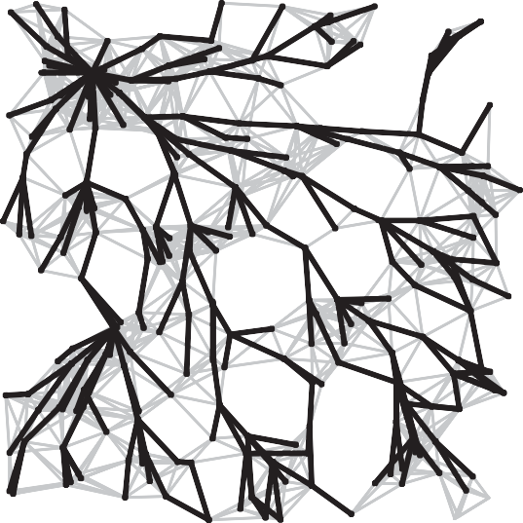
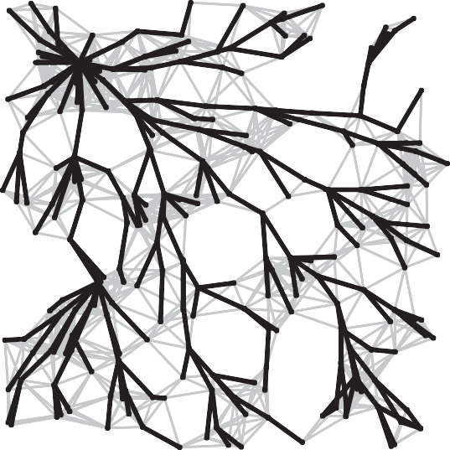
Bellman-Ford Algorithm Visualization
passes 4
7
10
13
SPT

Slide 47
Quiz
Given a directed graph where weight of every edge is same, we can most efficiently find shortest path from a given source to destination using?
A. Breadth First Traversal
B. Dijkstra\'s Shortest Path Algorithm
C. Neither Breadth First Traversal nor Dijkstra\'s algorithm can be used
D. Depth First Search
ANS: A
With BFS, we first explore vertices at one edge distance, then all vertices at 2 edge distance, and so on.

Slide 48
Quiz
Which of the following statement(s)is / are correct regarding Bellman-Ford shortest path algorithm?
P: Always finds a negative weighted cycle, if one exist s.
Q: Finds whether any negative weighted cycle is reachable
from the source.
ANS: Q
Bellman-Ford shortest path algorithm is a single source shortest path algorithm. So it can only find cycles which are reachable from a given source, not any negative weight cycle. Consider a disconnected where a negative weight cycle is not reachable from the source at all. If there is a negative weight cycle, then it will appear in shortest path as the negative weight cycle will always form a shorter path when iterated through the cycle again and again.

Slide 49
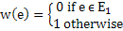
Quiz
Let G = (V, E) be an undirected graph with a subgraph G1 = (V1, El). Weights are assigned to edges of G as follows :
A single-source shortest path algorithm is executed on the weighted graph (V, E, w) with an arbitrary vertex ν1 of V1 as the source. Which of the following can always be inferred from the path costs computed?
A. The number of edges in the shortest paths from ν1 to all vertices of G
B. G1 is connected or not
C. V1 forms a clique in G
D. G1 is a tree
ANS: B
When shortest path shortest path from v1 (one of the vertices in V1) is computed. G1 is connected if the distance from v1 to any other vertex in V1 is greater than 0, otherwise G1 is disconnected.

Slide 50
Quiz
Let G = (V, E) be a simple undirected graph, and s be a particular vertex in it called the source. For x ∈ V, let d(x) denote the shortest distance in G from s to x. A breadth first search (BFS) is performed starting at s. Let T be the resultant BFS tree. If (u, v) is an edge of G that is not in T, then which one of the following CANNOT be the value of d(u) – d(v)?
A. -1 B. 0 C. 1 D. 2
ANS: D
Note that the given graph is undirected, so an edge (u, v) also means (v, u) is also an edge. Since a shorter path can always be obtained by using edge (u, v) or (v, u), the difference between d(u) and d(v) can not be more than 1.

Slide 51
Dijkstra's Algorithm vs. Bellman-Ford Algorithm
Dijkstra's Algorithm:
Uses a priority queue to select the next vertex to process.
Greedily selects the vertex with the smallest tentative distance to source node.
Works only on graphs with non-negative edge weights.
Time complexity of O(V^2) for a dense graph and O(E log V) for a sparse graph.
Bellman-Ford Algorithm:
Iteratively relaxes all edges V-1 times, where V is the number of vertices.
Does not use a priority queue.
Can handle graphs with negative edge weights, and can detect negative cycles.
Time complexity of O(VE), where V is the number of vertices and E is the number of edges in the graph.
Dijkstra's algorithm is faster and more efficient for graphs with non-negative weights, the Bellman-Ford algorithm is more versatile as it can handle negative weights and detect negative cycles, albeit at the cost of lower efficiency.
Notes:
Dijkstra's Algorithm:
- Finds the shortest path from a single source vertex to all other vertices in a graph with non-negative edge weights.
**Bellman-Ford Algorithm:**
- Finds the shortest path from a single source vertex to all other vertices in a graph, even with negative edge weights.
- Can detect negative cycles in the graph.
## Edge Weight Handling
**Dijkstra's Algorithm:**
- Works only on graphs with non-negative edge weights.
**Bellman-Ford Algorithm:**
- Can handle graphs with negative edge weights.
- Can detect negative cycles.
## Performance
Dijkstra's Algorithm:
- More efficient for graphs with non-negative weights.
- Time complexity: O(V log V + E) with a binary heap implementation, where V is the number of vertices and E is the number of edges.
**Bellman-Ford Algorithm:**
- Generally slower than Dijkstra's.
- Time complexity: O(VE), where V is the number of vertices and E is the number of edges.
## Implementation

Slide 52
Time complexity of Bellman-Ford
What is the time complexity of Bellman-Ford single-source shortest path algorithm on a complete graph of n vertices?
ANS: O(V3)
Time complexity of Bellman-Ford algorithm is O(VE) where V is number of vertices and E is number edges . If the graph is complete, the value of E becomes O(V2). So overall time complexity becomes O(V3)

Slide 53

Single Source Shortest-paths Implementation: Cost Summary
(omitted)
Remark 1. Directed cycles make the problem harder.
Remark 2. Negative weights make the problem harder.
Remark 3. Negative cycles makes the problem intractable.

Slide 54
Quiz
Which of the following algorithm can be used to efficiently calculate single source shortest paths in a Directed Acyclic Graph?
Dijkstra
Bellman-Ford
Topological Sort
Strongly Connected Component
ANS: Topological Sort
Using Topological Sort, we can find single source shortest paths in O(V+E) time which is the most efficient algorithm

Slide 55
Quiz
Given a graph where all edges have positive weights, the shortest paths produced by Dijsktra and Bellman Ford algorithm may be different but path weight would always be same.
ANS: True
Dijkstra and Bellman-Ford both work fine for a graph with all positive weights, but they are different algorithms and may pick different edges for shortest paths.

Slide 56
Floyd Warshall Algorithm
The Floyd Warshall Algorithm is an all pair shortest path algorithm unlike Dijkstra and Bellman Ford which are single source shortest path algorithms.
It works for both the directed and undirected weighted graphs. But, it does not work for the graphs with negative cycles
It follows Dynamic Programming approach to check every possible path going via every possible node in order to calculate shortest distance between every pair of nodes.
For k = 0 to n – 1 For i = 0 to n – 1 For j = 0 to n – 1 Distance[i, j] = min(Distance[i, j], Distance[i, k] + Distance[k, j])
where i = source Node, j = Destination Node, k = Intermediate Node
Time Complexity: O(V3), where V is the number of vertices in the graph and we run three nested loops each of size V

Slide 57

Floyd Warshall Algorithm is Dynamic Programming
Floyd Warshall Algorithm is a Dynamic Programming based algorithm. It finds all pairs shortest paths using following recursive nature of problem. For every pair (i, j) of source and destination vertices respectively, there are two possible cases. 1) k is not an intermediate vertex in shortest path from i to j. We keep the value of dist[i][j] as it is. 2) k is an intermediate vertex in shortest path from i to j. We update the value of dist[i][j] as dist[i][k] + dist[k][j]. The following figure is taken from the Cormen book. It shows the above optimal substructure property in the all-pairs shortest path problem.
Since there are overlapping subproblems in recursion, it uses dynamic programming

Slide 58

Floyd Warshall Algorithm Example

Slide 59

Step 1: Initialize the Distance[][] matrix using the input graph such that Distance[i][j]= weight of edge from i to j, also Distance[i][j] = Infinity if there is no edge from i to j.

Slide 60

Step 2: Treat node A as an intermediate node and calculate the Distance[][] for every {i,j} node pair using the formula:
= Distance[i][j] = minimum (Distance[i][j], Distance[i][A] + Distance[A][j])

Slide 61

Step 3: Treat node B as an intermediate node and calculate the Distance[][] for every {i,j} node pair using the formula: = Distance[i][j] = minimum (Distance[i][j], Distance[i][B] + Distance[B][j])

Slide 62

Step 4: Treat node C as an intermediate node and calculate the Distance[][] for every {i,j} node pair using the formula: = Distance[i][j] = minimum (Distance[i][j], Distance[i][C] + Distance[C][j])

Slide 63

Step 5: Treat node D as an intermediate node and calculate the Distance[][] for every {i,j} node pair using the formula: = Distance[i][j] = minimum (Distance[i][j], Distance[i][D] + Distance[D][j])

Slide 64

Step 6: Treat node E as an intermediate node and calculate the Distance[][] for every {i,j} node pair using the formula: = Distance[i][j] = minimum (Distance[i][j], Distance[i][E] + Distance[E][j])

Slide 65

Step 7: Since all the nodes have been treated as an intermediate node, we can now return the updated Distance[][] matrix as our answer matrix.

Slide 66
Johnson’s algorithm for All-pairs shortest paths
Johnson’s algorithm uses both Dijkstra and Bellman-Ford as subroutines. If we apply Dijkstra’s Single Source shortest path algorithm for every vertex, considering every vertex as the source, we can find all pair shortest paths in O(V*VLogV) time.
Dijkstra’s algorithm doesn’t work for negative weight edge. The idea of Johnson’s algorithm is to re-weight all edges and make them all positive, then apply Dijkstra’s algorithm for every vertex.
How to transform a given graph into a graph with all non-negative weight edges?
https://www.geeksforgeeks.org/johnsons-algorithm/

Slide 67
Quiz: increase weight of every edge by 1
In a weighted graph, assume that the shortest path from a source 's' to a destination 't' is correctly calculated using a shortest path algorithm. Is the following statement true? If we increase weight of every edge by 1, the shortest path always remains same.
See the following counterexample. There are 4 edges s-a, a-b, b-t and s-t of wights 1, 1, 1 and 4 respectively. The shortest path from s to t is s-a, a-b, b-t=3. IF we increase weight of every edge by 1, the shortest path changes to s-t = 5.
s
1
a
1
b
1
t
4
Notes:
1 1
s-----a-----b-----t
\ /
\ /
\ __4 __/

Slide 68
Quiz: Doubling of the original weight
Is the following statement valid about shortest paths? Given a graph, suppose we have calculated shortest path from a source to all other vertices. If we modify the graph such that weights of all edges is becomes double of the original weight, then the shortest path remains same only the total weight of path changes.
True.
The shortest path remains same. It is like if we change unit of distance from meter to kilo meter, the shortest paths don\'t change. But this does not make weights positive.

Slide 69
Johnson’s algorithm for All-pairs shortest paths
Let the given graph be G. Add a new vertex s to the graph, add edges from the new vertex to all vertices of G. Let the modified graph be G’.
Run the Bellman-Ford algorithm on G’ with s as the source. Let the distances calculated by Bellman-Ford be h[0], h[1], .. h[V-1]. If we find a negative weight cycle, then return.
Reweight the edges of the original graph. For each edge (u, v), assign the new weight as “original weight + h[u] – h[v]”.
Remove the added vertex s and run Dijkstra’s algorithm for every vertex.
Notes:
Note that the negative weight cycle cannot be created by new vertex s as there is no edge to s. All edges are from s.

Slide 70



Johnson’s Algorithm Example
We add a source s and add edges from s to all vertices of the original graph. In the following diagram s is 4.
We calculate the shortest distances from 4 to all other vertices using Bellman-Ford algorithm. The shortest distances from 4 to 0, 1, 2 and 3 are 0, -5, -1 and 0 respectively, i.e., h[] = {0, -5, -1, 0}. Once we get these distances, we remove the source vertex 4 and reweight the edges using following formula. w(u, v) = w(u, v) + h[u] – h[v].
Since all weights are positive now, we can run Dijkstra’s shortest path algorithm for every vertex as the source.
0
-5
0
-1

Slide 71
Johnson’s Algorithm: Proof
The following property is always true about h[] values as they are the shortest distances.
h[v] <= h[u] + w(u, v)
The property simply means that the shortest distance from s to v must be smaller than or equal to the shortest distance from s to u plus the weight of the edge (u, v). The new weights are w(u, v) + h[u] – h[v]. The value of the new weights must be greater than or equal to zero because of the inequality “h[v] <= h[u] + w(u, v)”.
After reweighting, all set of paths between any two vertices is increased by the same amount and all negative weights become non-negative. Consider any path between two vertices s and t, the weight of every path is increased by h[s] – h[t], and all h[] values of vertices on the path from s to t cancel each other.
Time complexity: The main steps in the algorithm are Bellman-Ford Algorithm called once and Dijkstra called V times. Time complexity of Bellman Ford is O(VE) and time complexity of Dijkstra is O(VLogV). So overall time complexity is O(V²log V + VE).
Notes:
We add a source s and add edges from s to all vertices of the original graph. In the following diagram s is 4.

Slide 72
Video Tutorials
Dijkstras Shortest Path Algorithm Explained | With Example | Graph Theory
https://www.youtube.com/watch?v=bZkzH5x0SKU
Dijkstra's algorithm in 3 minutes
https://www.youtube.com/watch?v=_lHSawdgXpI
Bellman-Ford in 4 minutes — Theory
https://www.youtube.com/watch?v=9PHkk0UavIM
Bellman-Ford in 5 minutes — Step by step example
https://www.youtube.com/watch?v=obWXjtg0L64
Floyd–Warshall algorithm in 4 minutes
https://www.youtube.com/watch?v=4OQeCuLYj-4

Slide 73
Quiz
Match the following
Group A
a) Dijkstra's single shortest path algo
b) Bellmen Ford's single shortest path algo
c) Floyd Warshall's all pair shortest path algo
Group B
p) Dynamic Programming
q) Backtracking
r) Greedy Algorithm
Dijkstra is a greedy algorithm where we pick the minimum distant vertex from not yet finalized vertices. Bellman Ford and Floyd Warshall both are Dynamic Programming algorithms where we build the shortest paths in bottom up manner.

Slide 74

Quiz
Consider a weighted undirected graph with positive edge weights and let uv be an edge in the graph. It is known that the shortest path from the source vertex s to u has weight 53 and the shortest path from s to v has weight 65. Which one of the following statements is always true?
A. weight (u, v) < 12
B. weight (u, v) ≤ 12
C. weight (u, v) > 12
D. weight (u, v) ≥ 12
ANS:
The minimum weight happens when (S,U) + (U,V) = (S,V) Else (S,U) + (U,V) >= (S,V) Given (S,U) = 53, (S,V) = 65, 53 + (U,V) >= 63, (U,V) >= 12.

Slide 75
Quiz
Let G be a directed graph whose vertex set is the set of numbers from 1 to 100. There is an edge from a vertex i to a vertex j if either j = i + 1 or j = 3i. The minimum number of edges in a path in G from vertex 1 to vertex 100 is
A. 4 B. 7 C. 23 D. 99
ANS: 7
The task is to find minimum number of edges in a path in G from vertex 1 to vertex 100 such that we can move to either i+1 or 3i from a vertex i.
Since the task is to minimize number of edges, we would prefer to follow 3*i. Let us follow multiple of 3. 1 => 3 => 9 => 27 => 81, now we can't follow multiple of 3 anymore. So we will have to follow i+1. This solution gives a long path.
What if we begin from end, and we reduce by 1 if the value is not multiple of 3, else we divide by 3. 100 => 99 => 33 => 11 => 10 => 9 => 3 => 1
So we need total 7 edges.

